Slide 1
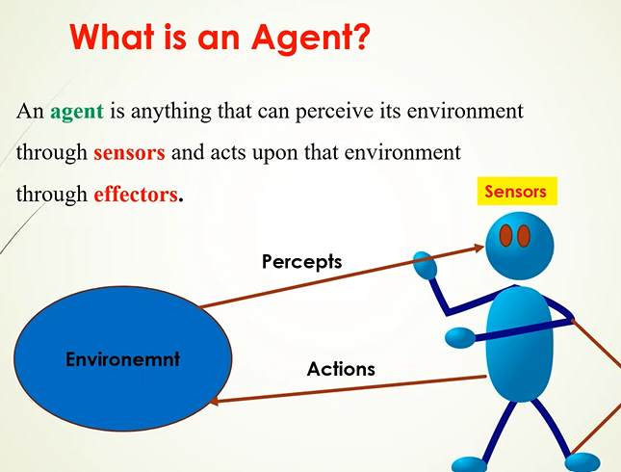

Slide 2
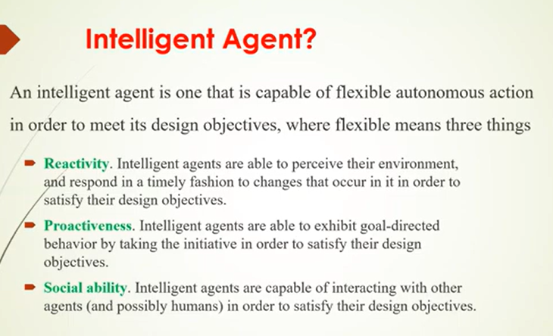

Slide 3
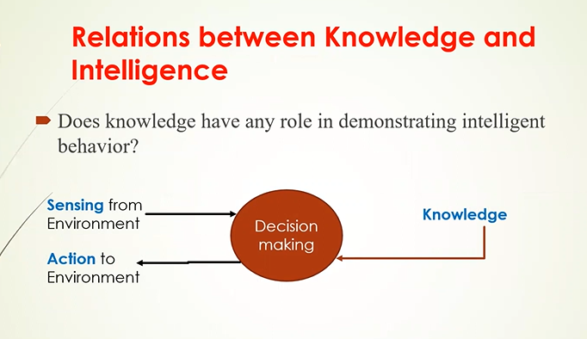

Slide 4
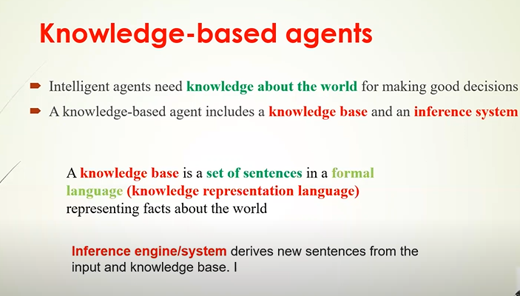

Slide 5
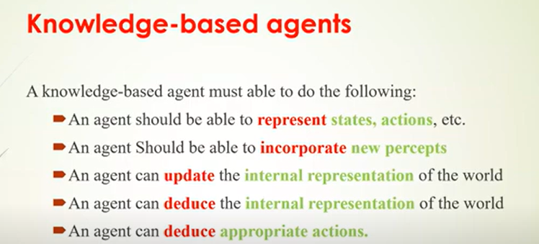

Slide 6
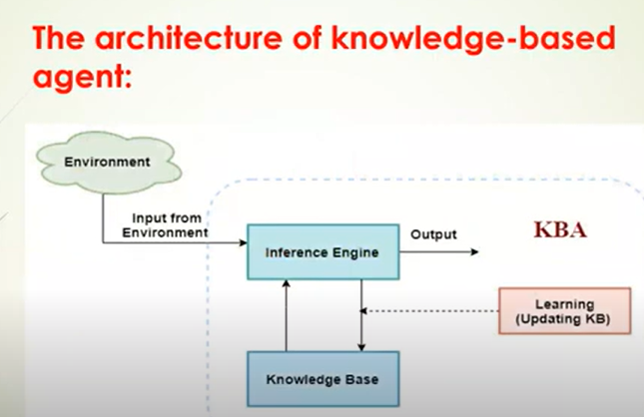

Slide 7
Operational mechanism
The operational mechanism of a knowledge-based agent can be segmented into the following steps:
● Environment perception: The agent's operation commences with it observing its environment, which could be via sensors or other input reception methods.
● Knowledge base modification: Based on the observed input, the agent subsequently modifies its knowledge base. This could entail introducing new information, revising existing data, or discarding obsolete information.
● Inference engine application: After updating the knowledge base, the inference engine comes into play. This engine applies logical rules to extract new facts or infer new data from the knowledge base.

Slide 8
Action determination: Depending on the output of the inference engine, the agent decides on the most suitable action. This action is then implemented within the environment.
Learning from outcomes: Finally, the agent gains insight from the outcomes of its actions. It uses this feedback to modify its knowledge base and hone its future decision-making process.

Slide 9
Levels of Knowledge-based Agent
The knowledge-based agent can be described using three levels. These are:
● Knowledge level
● Logical level
● Implementation level
1. Knowledge level
● This is the basic and the most abstract level in a knowledge-based agent. This level describes the agent by what it knows, i.e. through its knowledge base. In this level, the information that the agent has, its goals and the utility are defined.
Example A house cleaning agent knows where the mop is and where the floor is and where the cleaning material like the soap and detergents are kept. All this is defined in the knowledge level.

Slide 10
2. Logical level
In the logical level, the raw and discrete information which is present in the knowledge level is encoded into sentences. In simple words, the agent in this level derives the logic out of the knowledge base according to the problem. It selects the required blocks of information and combines them meaningfully so as a decision could be made.
Example The house cleaning agent on getting all the information then checks and finds the place which is dirty and should be cleaned.

Slide 11
3. Implementation level
This is the final layer of the knowledge-based agent. In the implementation level, the logic which the agent has derived in the logical level is brought to implementation. This layer deals with the physical representation of the sentences.
Example The cleaning agent after finding the place to clean finally takes action and cleans the dirt on the floor and as a result, the agent gets clean floor which is the goal state that the agent is designed to achieve.

Slide 12
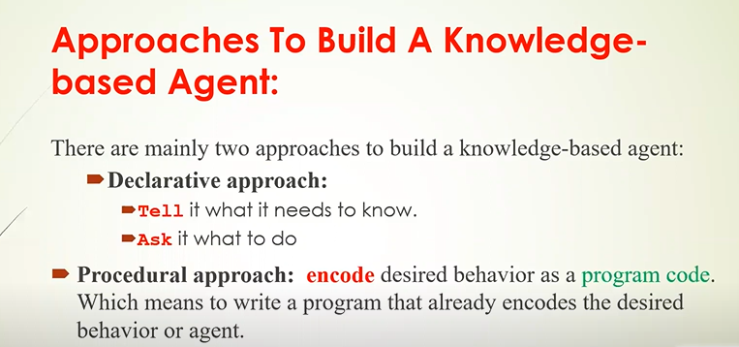

Slide 13
A simple knowledge-based agent function
KB-AGENT( percept) returns an action
static: KB, a knowledge base t, a counter, initially 0, indicating time TELL(KB, MAKE-PERCEPT-SENTENCE( percept, t))
action ← ASK(KB, MAKE-ACTION-QUERY(t))
TELL(KB, MAKE-ACTION-SENTENCE(action, t))
t ← t + 1 return action

Slide 14
The agent must be able to:
● Represent states, actions, etc.
● Incorporate new percepts
● Update internal representations of the world
● Deduce hidden properties of the world
● Deduce appropriate actions

Slide 15
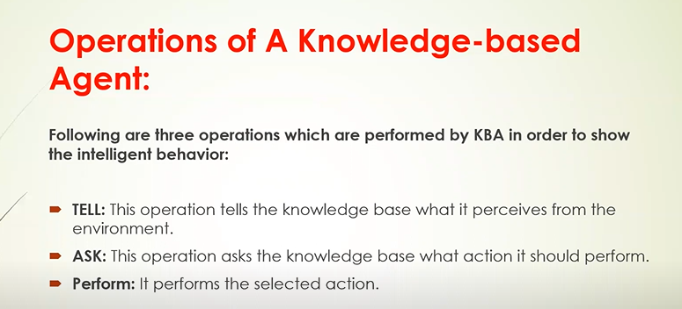

Slide 16
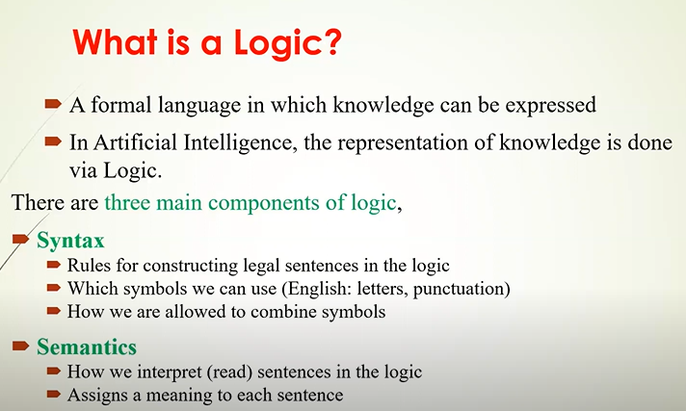

Slide 17
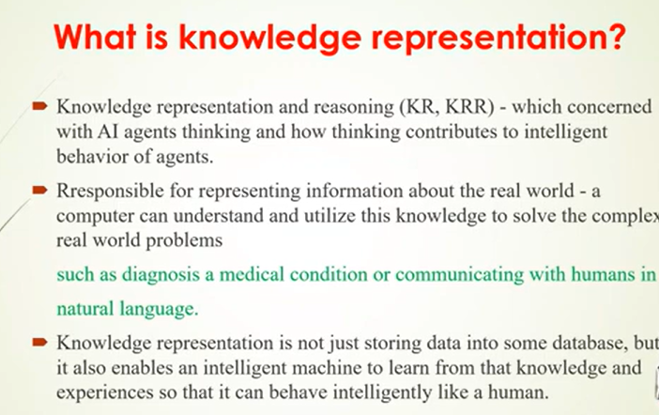

Slide 18
An Example: The Wumpus World!
Performance measure:
gold +1000,
death -1000,
-1 per step,
-10 for using the arrow
Environment:
● Squares adjacent to wumpus are smelly
Squares adjacent to pit are breezy
Glitter iff gold is in the square

Slide 19
Shooting kills wumpus
Grabbing picks up gold if in same square
Releasing drops the gold in same square
Actuators: Left turn, Right turn, Forward, Grab, Release, Shoot
Sensors: Breeze, Glitter, Smell Stench Breeze

Slide 20
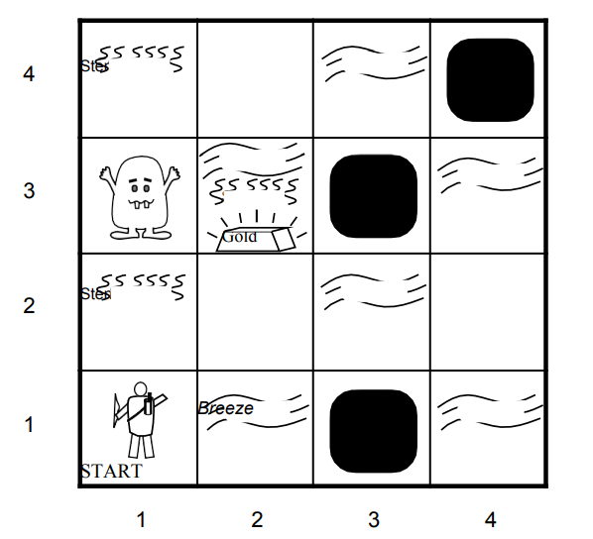
WUMPUS WORLD

Slide 21
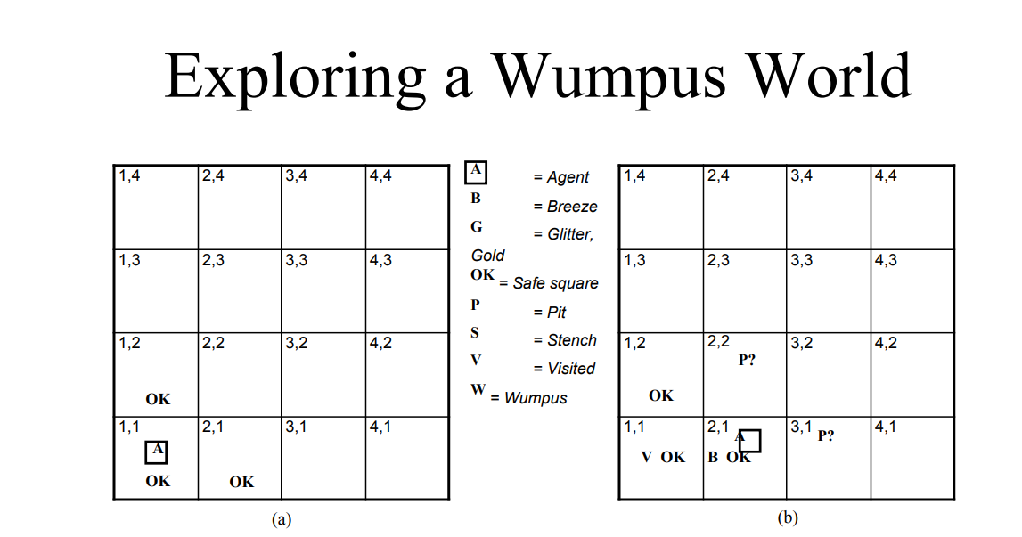

Slide 22
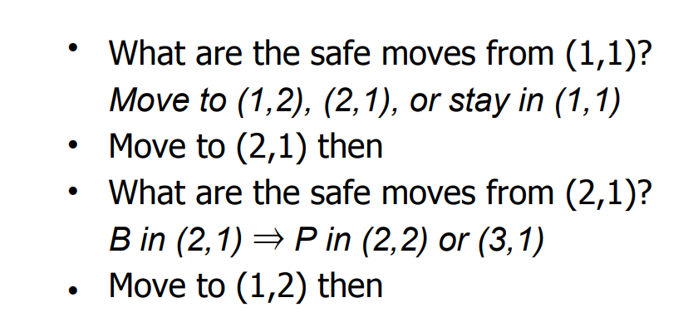

Slide 23
LOGIC

Slide 24
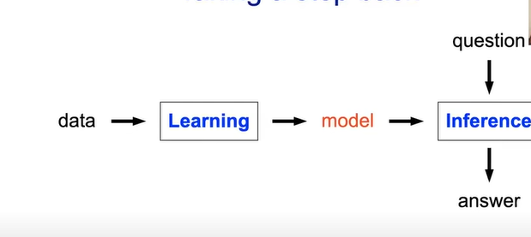
TAKING A STEP BACK

Slide 25
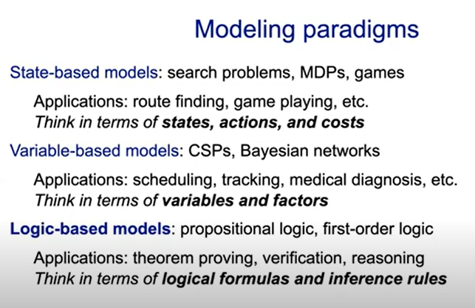

Slide 26
A HISTORICAL NOTE
Logic was dominant paradigm in AI before 1990s
Problem 1:deterministic,didn’t handle uncertainity (probability address this)
Problem 2: rule –based ,dint allow fine tuning from data(machine learning address this)
Strength: Provide expressiveness in a compact way

Slide 27
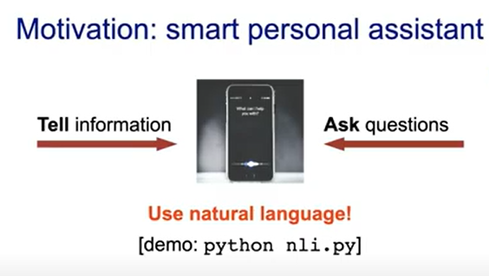
Need to:
Digest Heterogeneous Information
Reason deeply with that information

Slide 28
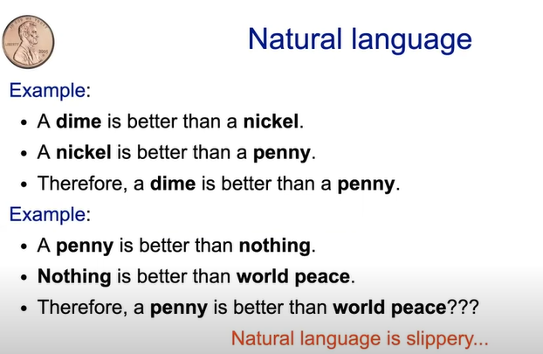

Slide 29
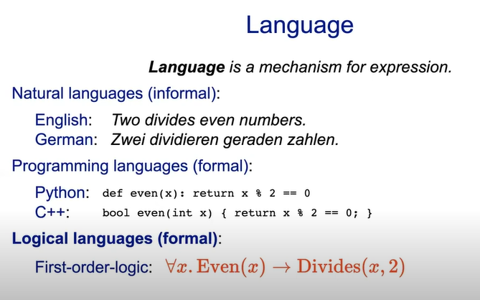

Slide 30
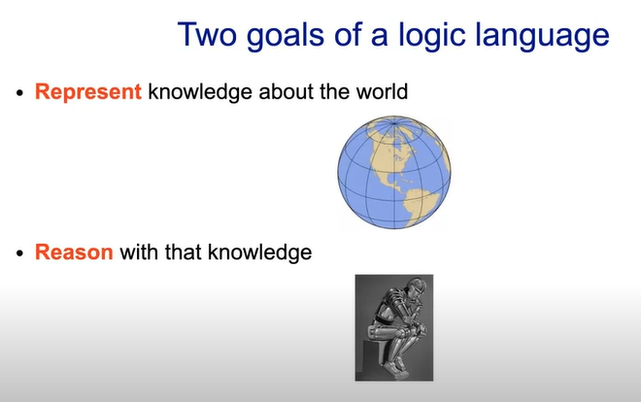

Slide 31
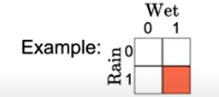
INGREDIENTS OF LOGIC
Syntax defines a set of valid formulas
Example:Rain ^ wet
Semantics : for each formula specify a set of models/assignments
Inference Rules: Given f,what new formulas g can be added that are guaranteed to follow f/g
Rain ^ Wet derive Rain

Slide 32
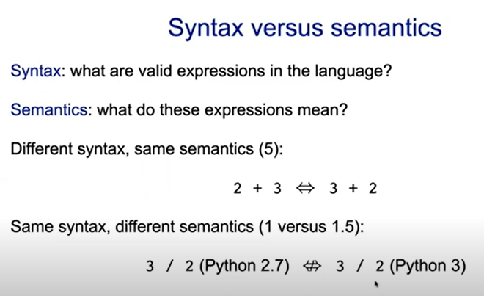

Slide 33
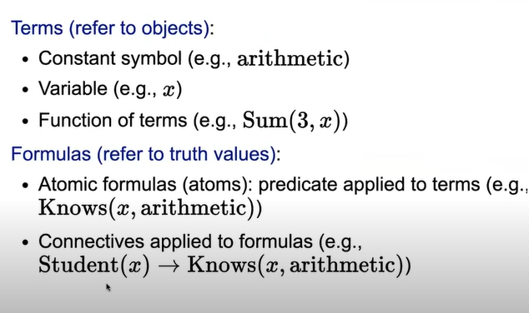
SYNTAX-FOL

Slide 34
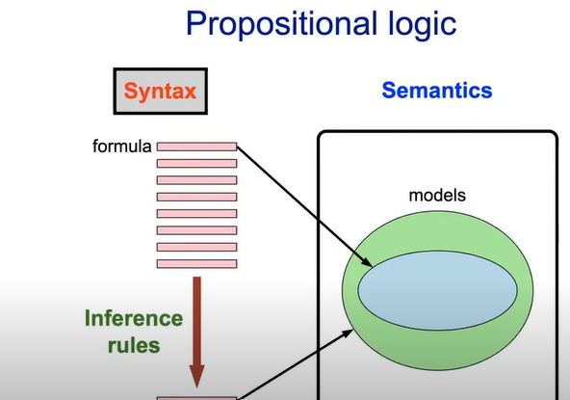
SEMANTICS

Slide 35
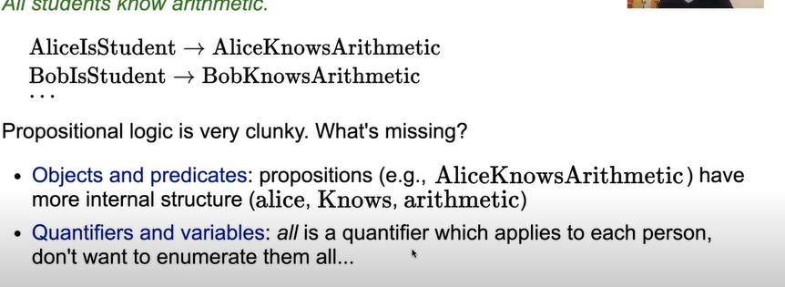

Slide 36
FOL
Sam is tall
John likes cricket
Everyone likes cricket
All students like cricket
Some boys are intelligent
Not all students like mathematics and science
F

Slide 37
FOL
Sam is tall
Tall(Sam)
John likes cricket
Likes(John,Cricket)
Everyone likes cricket
All students like cricket
Some boys are Intelligent
Not all students like mathematics and science
~(x,mathematics) ^ likes(x,Science))

Slide 38
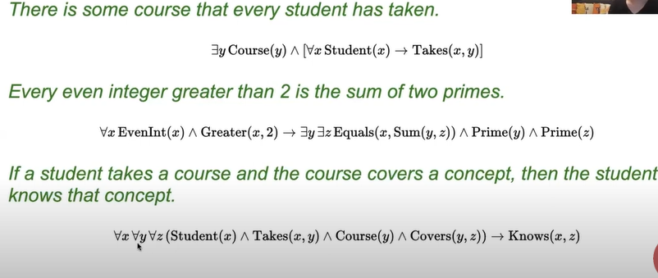

Slide 39
INFERENCE

Slide 40
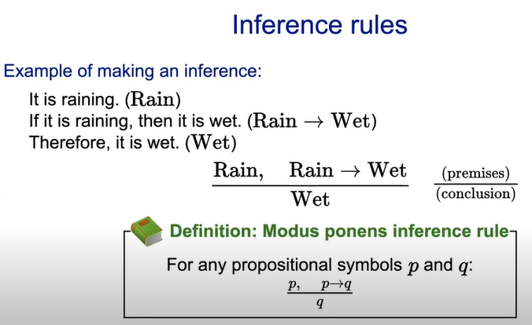

Slide 41
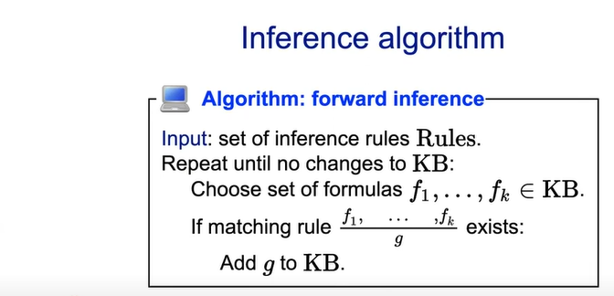
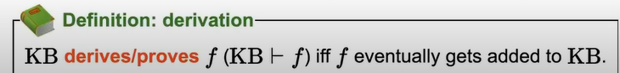

Slide 42
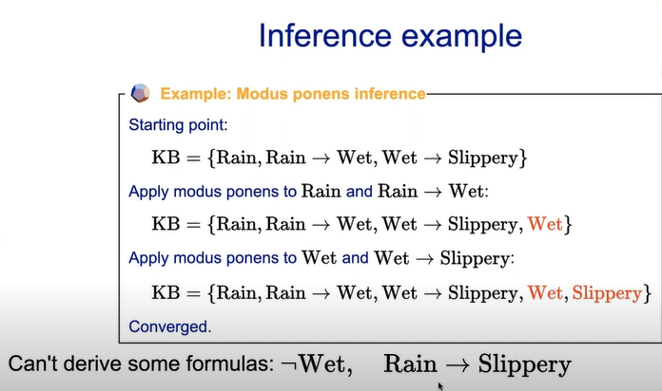

Slide 43
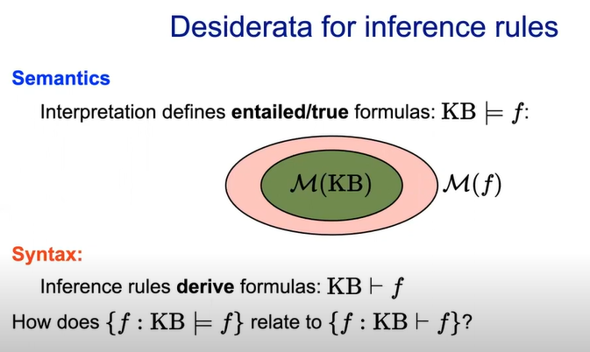

Slide 44
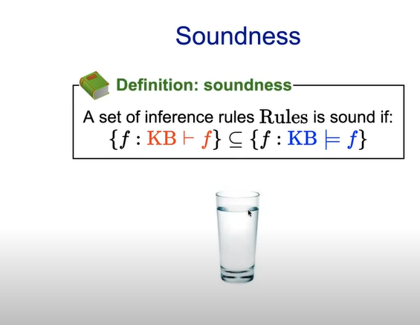

Slide 45
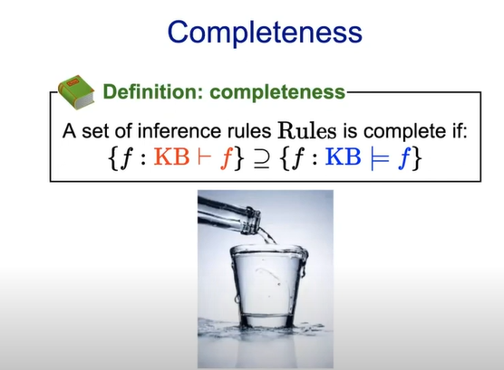

Slide 46
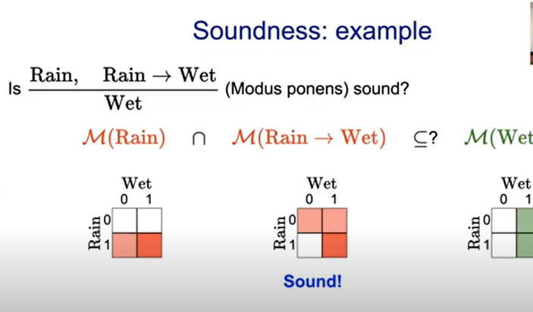

Slide 47
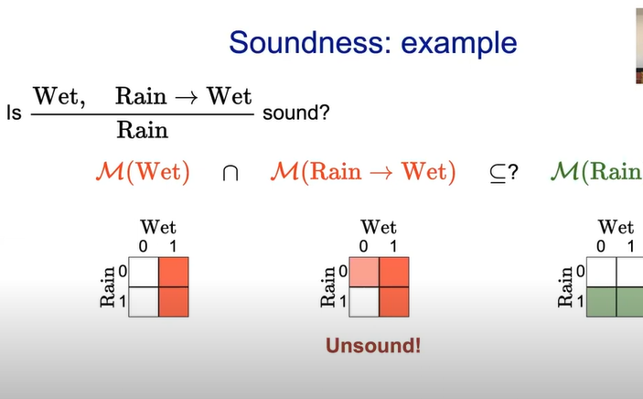

Slide 48
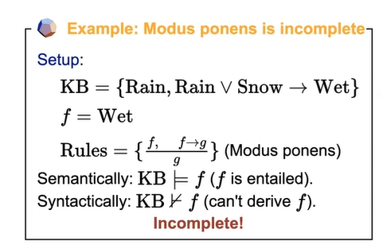
COMPLETENESS EXAMPLE

Slide 49
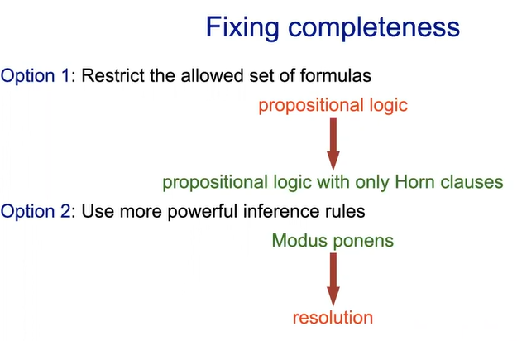

Slide 50
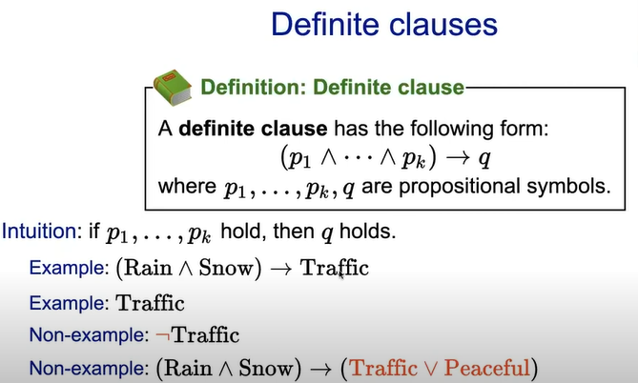

Slide 51
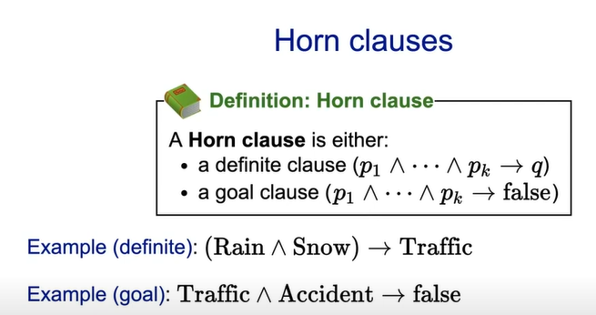

Slide 52
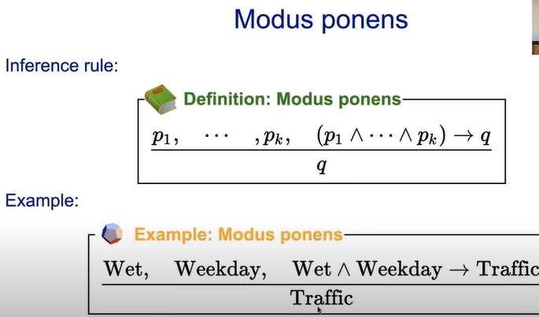

Slide 53
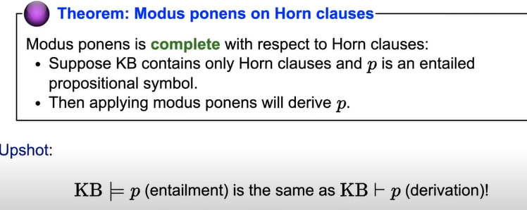
COMPLTENESS OF MODUS PONENS

Slide 54
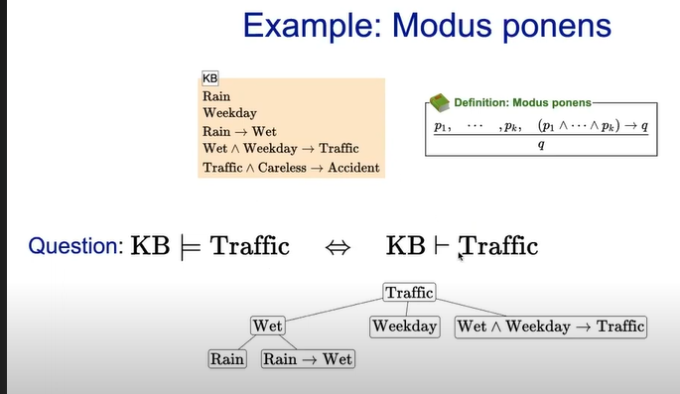

Slide 55
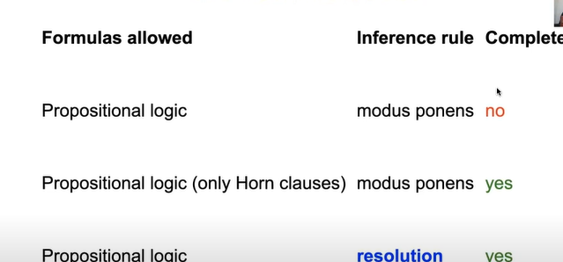
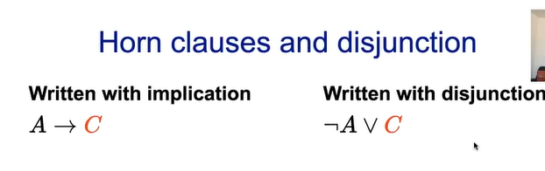

Slide 56
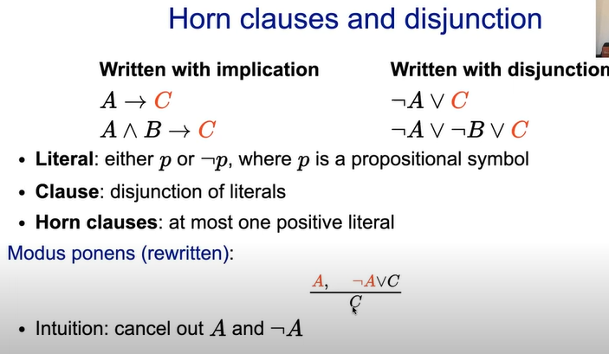

Slide 57
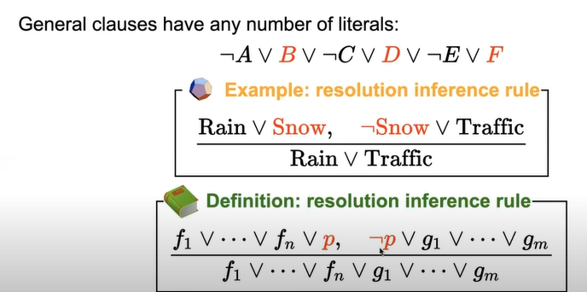
RESOLUTION

Slide 58
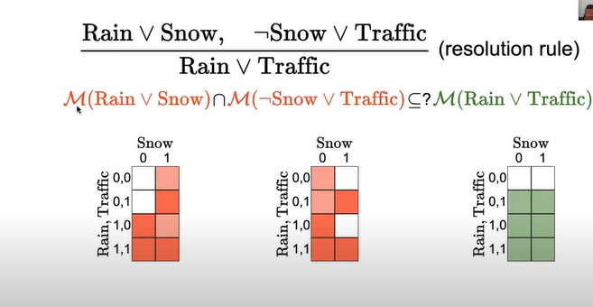
SOUNDNESS OF RESOLUTION

Slide 59
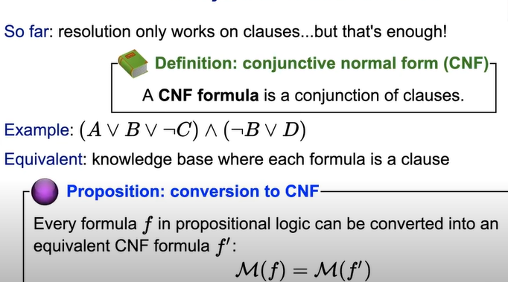
CONJUCTIVE NORMAL FORM

Slide 60
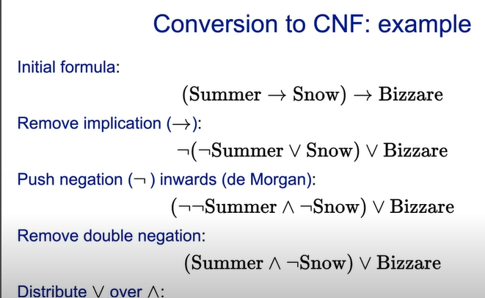
SUMMERV BIZZARE ^ !SNOW v BIZAARE

Slide 61
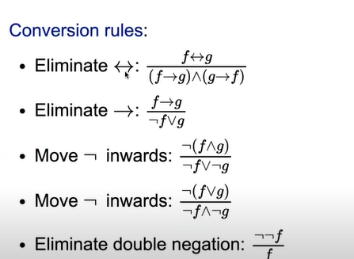

Slide 62
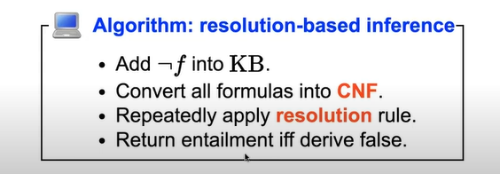

Slide 63



Slide 64

Modus Ponen-FOL

Slide 65



Slide 66



Slide 67


Slide 68


Slide 69
Resolution in FOL
Steps
Conversion of facts into FOL
Convert FOL in CNF
Negate the statement which needs to be proved
Draw Resolution graph (Unification)

Slide 70
Problem 1
1. All people who are graduating are happy.
2. All happy people smile.
3. Someone is graduating.
4. Conclusion: Is someone smiling?
Solution: Convert in to predicate Logic
1. ∀x[graduating(x)->happy(x)
2. ∀x(happy(x)->smile(x)
3. ∃x graduating(x)
4. ∃x !smile(x)
Convert to clausal form
Eliminate the -> sign
1. ∀x !graduating(x) vhappy(x)
2. ∀x! happy(x) v smile(x)
3. ∃x graduating(x)
4. !∃x smile(x)

Slide 71
(ii) Reduce the scope of negation
∀x !graduating(x) V happy(x)
∀x !happy(x) V smile(x)
∃x graduating(x)
∀x ! Smile(x)
(iii) Standardize variables apart
1.∀x !graduating(x) Vhappy(x)
2. ∀y !happy(y) V smile(y)
3. ∃z graduating(z)
4. ∀ w!smile(w)
(iv) Move all quantifiers to the left
.1.∀x !graduating(x) Vhappy(x)
2. ∀y !happy(y) v smile(y)
3. ∃z graduating(z)
4. ∀ w!smile(w)

Slide 72
(v) Eliminate ∃
1. ∀x!graduating(x) V happy(x)
2. ∀y !happy(y) v smile(y)
3. graduating(name)
4. ∀ w!smile(w)
(vi) Eliminate ∀
1. !graduating(x) vhappy(x)
2. !happy(y) v smile(y)
3. graduating(name)
4. !smile(w)

Slide 73

(vii) Convert to conjunct of disjuncts form. (viii) Make each conjunct a separate clause. (ix) Standardize variables apart again.

Slide 74
FACTS
John like all kind of food
Apple and Vegetable are food
Anything anyone eats and not killed is food
Anil eat peanut and still alive
Harry eats everything that anil eats
Anyone not killed is alive
Anyone alive is not killed
Conclusion : John like peanut

Slide 75


Slide 76

Remove Implication

Slide 77

Move negation inwards

Slide 78

Rename variables or standardized variables

Slide 79

Eliminate existential quantifiers

Slide 80

Drop Universal quantifier

Slide 81


Slide 82


Slide 83


Slide 84


Slide 85


Slide 86


Slide 87


Slide 88


Slide 89



Slide 90


Slide 91


Slide 92



Slide 93


Slide 94


Slide 95


Slide 96


Slide 97


Slide 98


Slide 99


Slide 100
MODULE 3 SEMANTIC NETWORKS

Slide 101



Slide 103


Slide 104


Slide 105


Slide 106


Slide 107


Slide 108


Slide 109


Slide 110


Slide 111


Slide 112


Slide 113
Knowledge Representation
Knowledge Representation, is an integral part of Artificial Intelligence (AI).
It works along with Reasoning to enable machines to comprehend and represent accumulated data and knowledge in a reasoning way.
It is concerned with thinking and how it contributes to intelligent machines.
Moreover, it uses various techniques to accomplish an accurate representation of knowledge. These techniques are:
Logical Representation.
Semantic Networks.
Production Rules.
Frames Representation.

Slide 114
SEMANTIC NETWORKS IN AI
Semantic Networks or Semantic Net is a knowledge representation technique used for propositional information.
Semantic Network is a directed or undirected graph consisting of vertices.
These vertices represent concepts and edges, which further represent semantic relations between concepts, mapping or connecting semantic fields.

Slide 115
COMPONENTS OF SEMANTIC NETWORKS:
Semantic Networks can further be defined by specifying its fundamental components, which are:
Lexical Components - Consists of: Nodes represent the object or concept.
Links: Denoting relation between nodes.
Labels: Denoting particular objects & relations.
Structural Component - Here the links and nodes form a directed graph wherein the labels are placed on the link and nodes.
Semantic Component - The meanings here are related to the links and labels of nodes, whereas the facts are dependent on the approved areas.
Procedural Part - The creation of new links and nodes is permitted by constructors, whereas the destructors are responsible for the removal of links and nodes.

Slide 116

Semantic network Representation

Slide 117

Simple example of Semantic Networks

Slide 118

Types of Semantic Networks

Slide 119


Slide 120


Slide 121
APPLICATION OF SEMANTIC NETWORKS:
In natural language processing applications like semantic parsing, word sense disambiguation, etc.
Specialized retrieval tasks, like plagiarism detection.
Knowledge Graph proposed by Google in 2012 uses semantic networks in the search engines.

Slide 122
ADVANTAGES OF SEMANTIC NETWORKS:
It is simple and comprehensible.
Efficient in space requirement.
Easily clusters related knowledge.
It is flexible and easy to visualize.
It is a natural representation of knowledge.
Conveys meaning in a transparent manner.

Slide 123
DISADVANTAGES OF SEMANTIC NETWORKS:
Inheritance cause problems.
Links on objects represent only binary options.
Interactable for large domains.
Don’t represent performances or meta-knowledge effectively.
It’s difficult to express some properties using Semantic Networks, like negation, disjunction, etc.

Slide 124
FRAMES Facets: The various aspects of a slot is known as Facets. Facets are features of frames which enable us to put constraints on the frames.
Slots | Filters
Title | Artificial Intelligence
Genre | Computer Science
Author | Peter Norvig
Edition | Third Edition
Year | 1996
Page | 1152

Slide 125
Advantages: Flexible Easy to add slots for new attributes and relations Disadvantages: In frame system inference mechanism is not be easily processed.
Slots | Filter
Name | Peter
Profession | Doctor
Age | 25
Marital status | Single
Weight | 78

Slide 126
Production Rules Production rules system consist of (condition, action) pairs which mean, "If condition then action".
IF (at bus stop AND bus arrives) THEN action (get into the bus)
IF (on the bus AND paid AND empty seat) THEN action (sit down).
IF (on bus AND unpaid) THEN action (pay charges).
IF (bus arrives at destination) THEN action (get down from the bus).

Slide 127
Advantages of Production rule:
The production rules are expressed in natural language.
The production rules are highly modular, so we can easily remove, add or modify an individual rule.
Disadvantages of Production rule:
Production rule system does not exhibit any learning capabilities, as it does not store the result of the problem for the future uses.

Slide 128
Inference rules:
Inference rules are the templates for generating valid arguments. Inference rules are applied to derive proofs in artificial intelligence, and the proof is a sequence of the conclusion that leads to the desired goal.
Some terminologies related to inference rules:
Implication: It is one of the logical connectives which can be represented as P → Q. It is a Boolean expression.
Converse: The converse of implication, which means the right-hand side proposition goes to the left-hand side and vice-versa. It can be written as Q → P.

Slide 129
Contrapositive: The negation of converse is termed as contrapositive, and it can be represented as ¬ Q → ¬ P.
Inverse: The negation of implication is called inverse. It can be represented as ¬ P → ¬ Q.
From the above term some of the compound statements are equivalent to each other, which we can prove using truth table:

Slide 130
Types of Inference rules:
1. Modus Ponens:
The Modus Ponens rule is one of the most important rules of inference, and it states that if P and P → Q
is true,
then we can infer that Q will be true. It can be represented as:
Statement-1: "If I am sleepy then I go to bed" ==> P→ Q Statement-2: "I am sleepy" ==> P Conclusion: "I go to bed." ==> Q. Example:
, we can say that, if P→ Q is true and P is true then Q will be true.

Slide 131
2. Modus Tollens:
The Modus Tollens rule state that if P→ Q is true and ¬ Q is true, then ¬ P will also true. It can be represented as:
Statement-1: "If I am sleepy then I go to bed" ==> P→ Q Statement-2: "I do not go to the bed."==> ~Q Statement-3 Which infers that "I am not sleepy" => ~P

Slide 132
3. Hypothetical Syllogism:
The Hypothetical Syllogism rule state that if P→R is true whenever P→Q is true, and Q→R is true. It can be represented as the following notation:
Example:
Statement-1: If you have my home key then you can unlock my home. P→Q Statement-2: If you can unlock my home then you can take my money. Q→R Conclusion: If you have my home key then you can take my money. P→R

Slide 133

4. Disjunctive Syllogism:
The Disjunctive syllogism rule state that if P∨Q is true, and ¬P is true, then Q will be true. It can be represented as:
Example:
Statement-1: Today is Sunday or Monday. ==>P∨Q Statement-2: Today is not Sunday. ==> ¬P Conclusion: Today is Monday. ==> Q

Slide 134
5. Addition:
The Addition rule is one the common inference rule, and it states that If P is true,
then P∨Q will be true.
Statement: I have a vanilla ice-cream. ==> P Statement-2: I have Chocolate ice-cream. Conclusion: I have vanilla or chocolate ice-cream. ==> (P∨Q)

Slide 135
6. Simplification:
The simplification rule state that if P∧ Q is true, then Q or P will also be true.
It can be represented as:

Slide 136
Resolution
Given two clauses:
(A∨P)(
(B∨¬P)
Where P is a literal, and A and B are disjunctions of other literals.
Resolution produces a new clause:
(A∨B)

Slide 137
CSD 3102 ARTIFICIAL INTELLIGENCE TECHNIQUES MODULE IV
PLANNING

Slide 138

What is a Plan?
A sequence (list) of actions, with variables replaced by constants (specific objects in the environment)
Planner

Slide 139
PLANNING:
The task of coming up with a sequence of actions that will achieve a goal is called planning.
Classical planning:
We consider only environments that are fully observable, deterministic, finite, static (change happens only when the agent acts), and discrete (in time, action, objects, and effects). These are called classical planning environments.
Non-classical planning:
Non-classical planning is for partially observable or stochastic environments and involves a different set of algorithms and agent designs.

Slide 140
PLANNING PROBLEM:
1. Overwhelmed by irrelevant actions:
Consider the task of buying a copy of AI book: A Modern Approach from an online bookseller. Suppose there is one buying action for each 10-digit ISBN number, for a total of 10 billion actions.
The search algorithm would have to examine the outcome states of all 10 billion actions to find one that satisfies the goal, which is to own a copy of ISBN 0137903952. an explicit goal description such as, Have(ISBN0137903952) and generate the action Buy(ISBN0137903952).

Slide 141
2. Finding a good heuristic function:
Suppose the agent's goal is to buy four different books online. Then there will be 1040 plans of just four steps, so searching without an accurate heuristic is difficult. It requires a human to supply a heuristic function for each new problem. For the book-buying problem, the goal would be Have(A) ∧ Have (B) ∧ Have(C) ∧ Have(D) , and a state containing Have (A) ∧ Have(C) would have cost 2. Thus, the agent automatically gets the right heuristic for this problem.
3. Problem decomposition:
The problem solver might be inefficient because it cannot take advantage of problem decomposition.
Consider the problem of delivering a set of overnight packages to their respective destinations, which are scattered across Australia.
It makes sense to find out the nearest airport for each destination and divide the overall problem into several subproblems, one for each airport.

Slide 142
THE LANGUAGE OF PLANNING PROBLEMS:
The representation of planning problems-states, actions, and goals-should make it possible for planning algorithms to take advantage of the logical structure of the problem.
The basic representation language of classical planners, known as the STRIPS(Stanford Research Institute Problem Solver) language.
STRIPS is insufficiently expressive for some real domains where Action Description Language (ADL) can be used.
Planning consists of following components:
Representation of states. Planners decompose the world into logical conditions and represent a state as a conjunction of positive literals. We will consider propositional literals;
Representation of goals. A goal is a partially specified state, represented as a conjunction of positive ground literals.
Representation of actions. An action is specified in terms of the preconditions that must hold before it can be executed and the effects that ensue when it is executed.

Slide 143
THE LANGUAGE OF PLANNING PROBLEMS:
In general, an action schema consists of three parts:
The action name and parameter list-for example, Fly(p, from, to)-serves to identify the action.
The precondition is a conjunction of function-free positive literals stating which must be true in a state before the action can be executed. Any variables in the precondition must also appear in the action's parameter list.
The effect is a conjunction of function-free literals describing how the state changes when the action is executed. A positive literal P in the effect is asserted to be true in the state resulting from the action, whereas a negative literal ⌐P is asserted to be false. Variables in the effect must also appear in the action's parameter list.

Slide 144

STRIPS Examples: Example: Air cargo transport
An air cargo transport problem involving loading and unloading cargo onto and off of planes and flying it from place to place. The problem can be defined with three actions: Load, Unload, and Fly.
The actions affect two predicates: In(c, p) means that cargo c is inside plane p, and A t ( x , a) means that object x (either plane or cargo) is at airport a.
A STRIPS problem involving transportation of air cargo between airports..

Slide 145
The following plan is a solution to the Air Cargo Transport problem:

Slide 146
Example: The spare tire problem
Consider the problem of changing a flat tire. More precisely, the goal is to have a good spare tire properly mounted onto the car's axle, where the initial state has a flat tire on the axle and a good spare tire in the trunk. There are just four actions:
Removing the spare from the trunk
Removing the flat tire from the axle
Putting the spare on the axle
Leaving the car unattended overnight.
We assume that the car is in a particularly bad neighborhood, so that the: effect of leaving it overnight is that the tires disappear.

Slide 147

Example: The spare tire problem

Slide 148

Building Block world problem

Slide 149
COMPONENTS OF A PLANNING SYSTEM:
Choose the best rule to apply the next rule based on the best available guess.
Apply the chosen rule to calculate the new problem condition.
Find out when a solution has been found.
Detect dead ends so they can be discarded and direct system effort in more useful directions.
Find out when a near-perfect solution is found.

Slide 150

PLANNING WITH STATE SPACE SEARCH: Planning Algorithm
The most straightforward approach is to use state-space search.
Because the descriptions of actions in a planning problem specify both preconditions and effects, it is possible to search in either direction: either forward from the initial state or backward from the goal.
we have Forward State Space Planning (FSSP) and Backward State Space Planning (BSSP) at the basic level.

Slide 151

Forward State Space Planning (FSSP)
FSSP behaves in the same way as forwarding state-space search.
It says that given an initial state S in any domain, we perform some necessary actions and obtain a new state S' (which also contains some new terms), called a progression.
It continues until we reach the target position. Action should be taken in this matter.

Slide 152

Backward State Space Planning (BSSP)
BSSP behaves similarly to backward state-space search. In this, we move from the target state g to the sub-goal g, tracing the previous action to achieve that goal.
This process is called regression (going back to the previous goal or sub-goal). These sub-goals should also be checked for consistency. The action should be relevant in this case.

Slide 153
Partial Order Planning

Slide 154
The Planning Problem
Formally a planning algorithm has three inputs:
A description of the world in some formal language,
A description of the agent’s goal in some formal language, and
A description of the possible actions that can be performed.
The planner’s o/p is a sequence of actions which when executed in any world satisfying the initial state description will achieve the goal.

Slide 155
Representation for states and goals
In the STRIPS language, states are represented by conjunctions of function-free ground literals, that is, predicates applied to constant symbols, possibly negated. For example,
At(Home)^ ¬ Have(Milk)^ ¬ Have(Bananas)^ ¬ Have(Drill)^….
Goals are also described by conjunctions of literals. For example,
At(Home)^Have(Milk)^ Have(Bananas)^ Have(Drill)
Goals can also contain variables. For example, the goal of being at a store that sells milk would be represented as

Slide 156
Representations for actions
Our STRIPS operators consist of three components:
the action description is what an agent actually returns to the environment in order to do something.
the precondition is a conjunction of atoms (positive literals) that says what must be true before the operator can be applied.
the effect of an operator is a conjunction of literals (positive or negative) that describes how the situation changes when the operator is applied.
Here’s an example for the operator for going from one place to another:
Op(Action:Go(there), Precond:At(here)^Path(here, there), Effect:At(there)^ ¬At(here))

Slide 157
Search through World Space
The simplest way to build a planner is to cast the planning problem as search through the space of world states. Each node in the graph denotes a state of the world, and arcs connect worlds that can be reached by executing a single action. We would call it a situation space planner because it searches through the space of possible situations.
There are two types of planners:
Progression Planner: it searches forward from the initial situation to the goal situation.
Regression Planner: it searches backward from the goal situation to the initial situation.

Slide 158
Search through the Space of Plans
An alternative is to search through space of plans rather than space of situations i.e plan-space node denote plans
Start with a simple partial plan
Expand the plan until the complete plan is developed
Operators in this step:
Adding a step
Imposing an ordering that puts one step after another
Instantiating a previously unbound variable
The solution 🡪 final plan Path 🡪 irrelevant

Slide 159
Representation of Plans
Consider a simple problem:
Putting on a pair of shoes
Goal 🡪RightShoeOn ^ LeftShoeOn
Four operators:
Op(Action:RightShoe,PreCond:RightSockOn,Effect:RightShoeON)
Op(Action:RightSock , Effect: RightSockOn)
Op(Action:LeftShoe, Precond:LeftSockOn, Effect:LeftShoeOn)
Op(Action:LeftSock,Effect:LeftSockOn)

Slide 160
Least Commitment –
One should make choices only about things that you currently care about ,leaving the others to be worked out later.
Partial Order Planner –
A planner that can represent plans in which some steps are ordered (before or after) w.r.t each other and other steps are unordered.
Total Order Planner—
Planner in which plans consist of a simple lists of steps
Linearization of P—
A totally ordered plan that is derived from a plan P by adding constraints

Slide 161
Partial Order Plans:
Total Order Plans:
Start
Start
Start
Start
Start
Start
Start
Right
Sock
Right
Sock
Left
Sock
Left
Sock
Right
Sock
Left
Sock
Left
Sock
Right
Sock
Left
Sock
Left
Sock
Right
Sock
Right
Sock
Right
Shoe
Left
Shoe
Left Sock on
Right Sock on
Left
Shoe
Right
Shoe
Right
Shoe
Left
Sock
Right
Shoe
Left
Shoe
Left
Sock
Right
Sock
Left Shoe on
Right Shoe on
Left
Shoe
Right
Shoe
Left
Shoe
Right
Shoe
Left
Shoe
Right
Shoe
Finish
Finish
Finish
Finish
Finish
Finish
Finish

Slide 162
PARTIAL ORDER PLANNING ALGORITHM(POP ALGORITHM)
We will define the POP algorithm for partial-order planning. Each plan has the following four components, where the first two define the steps of the plan and the last two serve a bookkeeping function to determine how plans can be extended:
A set of actions that make up the steps of the plan. These are taken from the set of actions in the planning problem. The "empty" plan contains just the Start and Finish actions. Start has no preconditions and has as its effect all the literals in the initial state of the planning problem. Finish has no effects and has as its preconditions the goal literals of the planning problem.

Slide 163
A set of ordering constraints. Each ordering constraint is of the form
which is read as "A before B" and means that action A must be executed sometime before action B, but not necessarily immediately before. The ordering constraints must describe a proper partial order. Any cycle such as A B and B A
The above cycle represents a contradiction, so an ordering constraint cannot be added to the plan if it creates a cycle.

Slide 164
Causal Links—
A Causal Links is written as S_{i} ^{c}🡪 S_{j} and read as “ S_{i} achieves c for S_{j} “.Causal Links serve to record the purpose of steps in the plan:here a purpose of S_{i} is to achieve the precondition c of S_{j}
A set of causal links. A causal link between two actions A and B in the plan is written as A B and is read as "A achieves p for B." For example, the causal link asserts that RightSockOn is an effect of the RightSock action and a precondition of RightShoe.
A causal link between two actions A and B in the plan is written as A
A set of open preconditions. A precondition is open if it is not achieved by some action in the plan. Planners will work to reduce the set of open preconditions to the empty set, without introducing a contradiction.

Slide 165

For example, the final plan has the following components:

Slide 166
Start
At(s),Sells(s,Drill)
At(s),Sells(s,Milk)
At(s),Sells(s,Bananas)
Buy(Drill)
Buy(Milk)
Buy(bananas)
Have(Drill),Have(Milk),Have(Bananas),At(Home)
Finish
Start
At(HWS),Sells(HWS,Drill)
At(SM),Sells(SM,Milk)
At(SM),Sells(SM,Bananas)
Buy(Drill)
Buy(Milk)
Buy(bananas)
Have(Drill),Have(Milk),Have(Bananas),At(Home)
Finish

Slide 167
Start
At(Home)
At(Home)
Go(HWS)
Go(SM)
At(HWS),Sells(HWS,Drill)
At(SM),Sells(SM,Milk)
At(SM),Sells(SM,Bananas)
Buy(Drill)
Buy(Milk)
Buy(bananas)
Have(Drill),Have(Milk),Have(Bananas),At(Home)
Finish

Slide 168
Start
At(x)
At(x)
Go(HWS)
Go(SM)
At(HWS),Sells(HWS,Drill)
At(SM),Sells(SM,Milk)
At(SM),Sells(SM,Bananas)
Buy(Drill)
Buy(Milk)
Buy(bananas)
Have(Drill),Have(Milk),Have(Bananas),At(Home)
Finish

